Slide 1


Identifying transients with machine learning
Asher Grossman

Slide 2
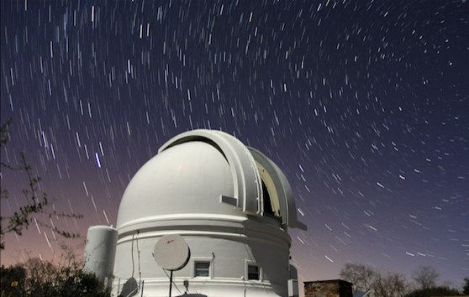
Existing situation
Bright Transient Survey
Backlog of “BTS rejects”
Machine learning can help
Notes:
BTS: mission is to all transients brighter than 19
There is a backlog of rejects that are not bright enough and thus unclassified, but may be interesting astronomical events

Slide 3
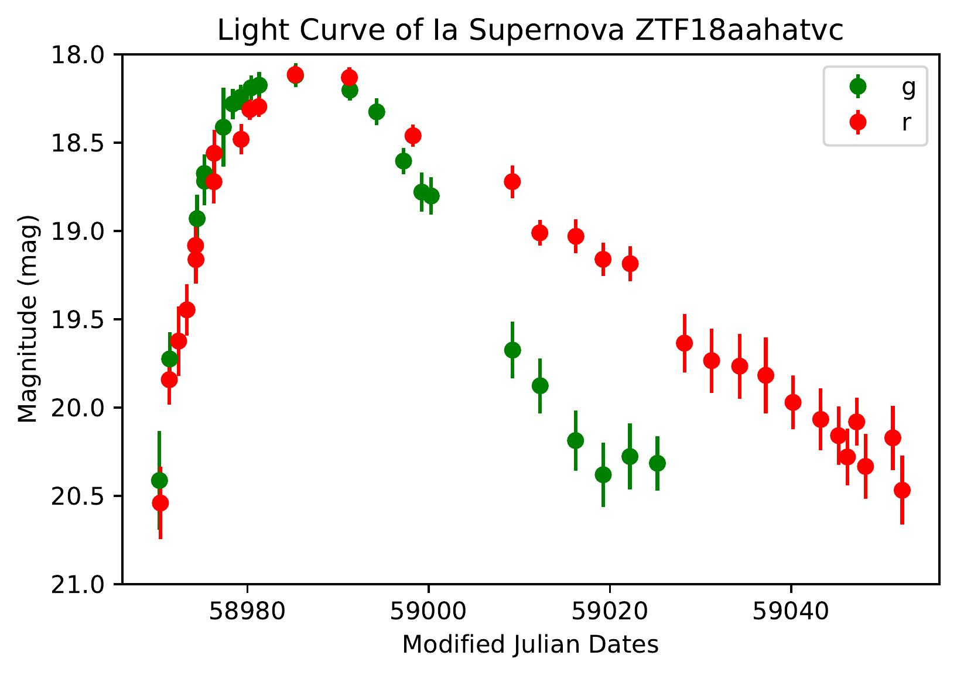
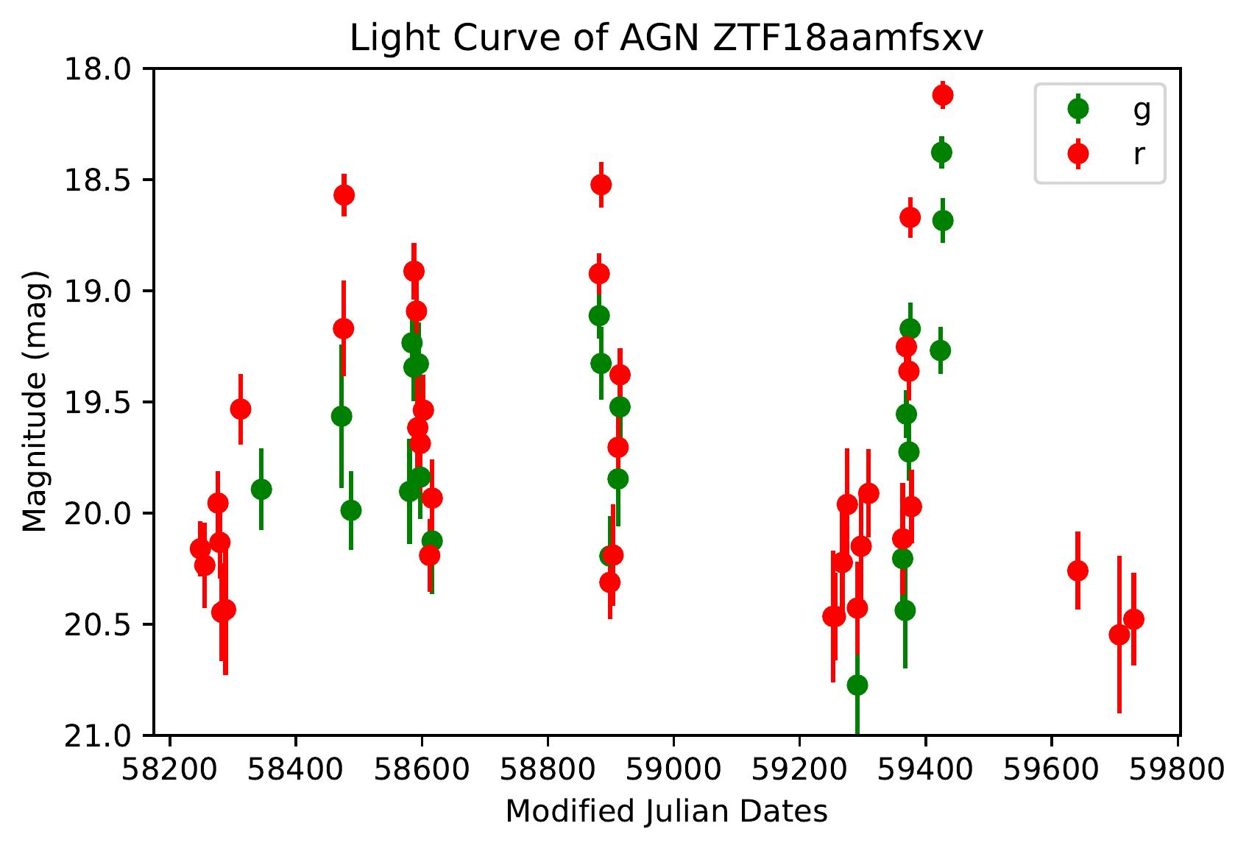
Transients and Variables
Transients
Variables
One time events
Supernovae
Gamma-ray bursts
Tidal disruption events
Repeated varying events
Active galactic nuclei
Cataclysmic variable stars
Notes:
These two categories aren’t all encompassing

Slide 4
My data
Data from Bright Transient Survey
Duration, rise, fade

Slide 5
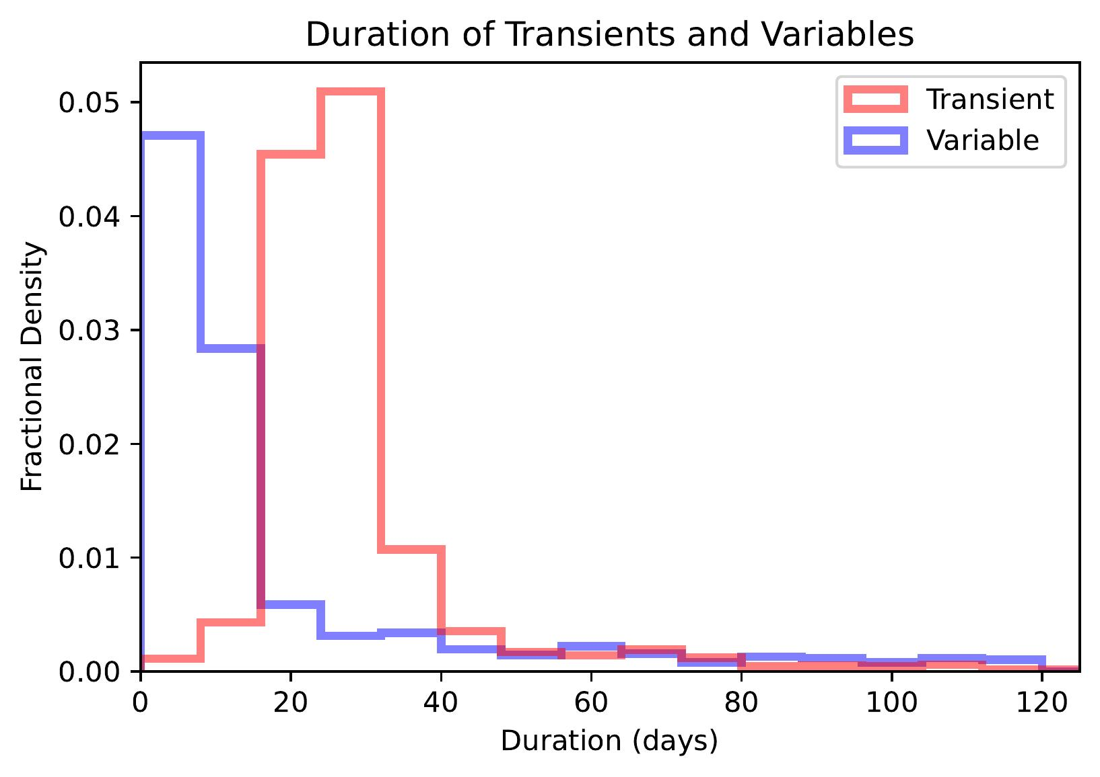
Duration
Notes:
Variables – why short duration if repeated?
CVs: one pulse is actually very short, so short duration is correct
AGNs: not very applicable to AGNs

Slide 6
My data
Data from Bright Transient Survey
Duration, rise, fade
Peak magnitude

Slide 7
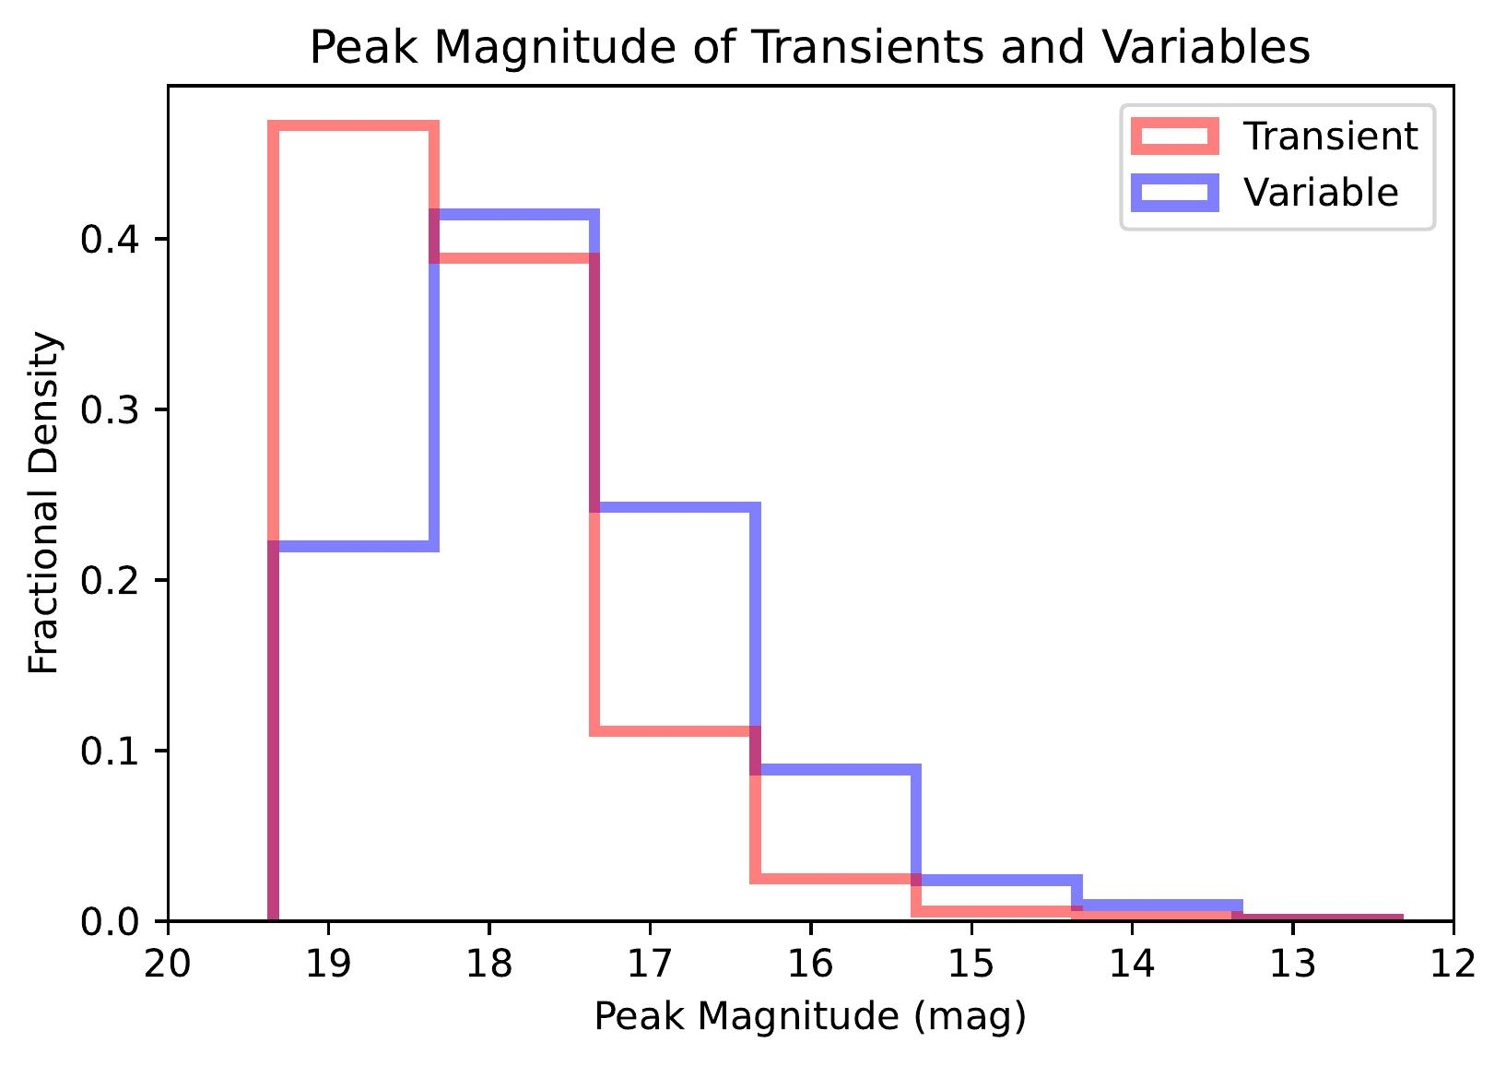
Peak Magnitude
Notes:
Avoid saying “not harmful”, say that I tested removing it and it performed marginally worse, even though there is a lot of overlap

Slide 8
My data
Data from Bright Transient Survey
Duration, rise, fade
Peak magnitude
Galactic latitude, Galactic extinction

Slide 9
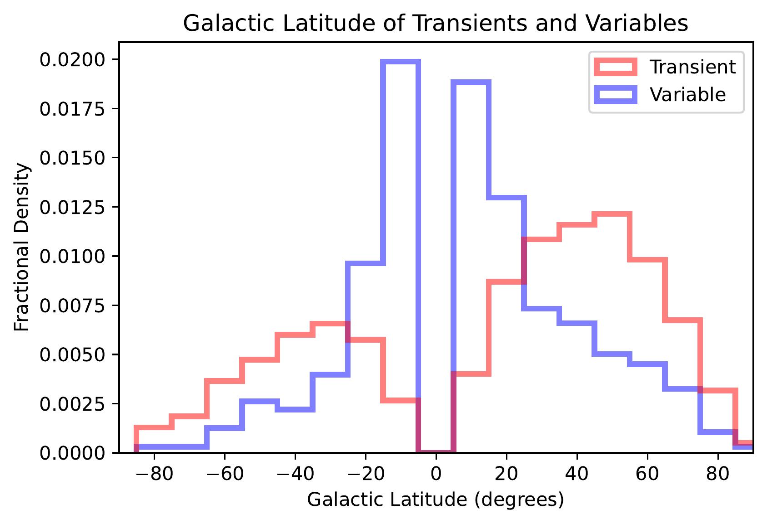
Galactic Latitude
Notes:
Many CVs in disk, hence large variable count for -20-20
BTS ignores center part of disk, difficult to see through
Consider changing bin size

Slide 10
My data
Data from Bright Transient Survey
Duration, rise, fade
Peak magnitude
Galactic latitude, Galactic extinction
Redshift, peak absolute magnitude (removed from model)
Notes:
CVs in milky way, don’t have redshifts
AGNs – BTS doesn’t take spectra for variables, as it is primarily focused on transients

Slide 11
My data
Data from Bright Transient Survey
Duration, rise, fade
Peak magnitude
Galactic latitude, Galactic extinction
Redshift, peak absolute magnitude (removed from model)
BTS cuts applied to original dataset
Notes:
Peak mag – 0.75mag

Slide 12
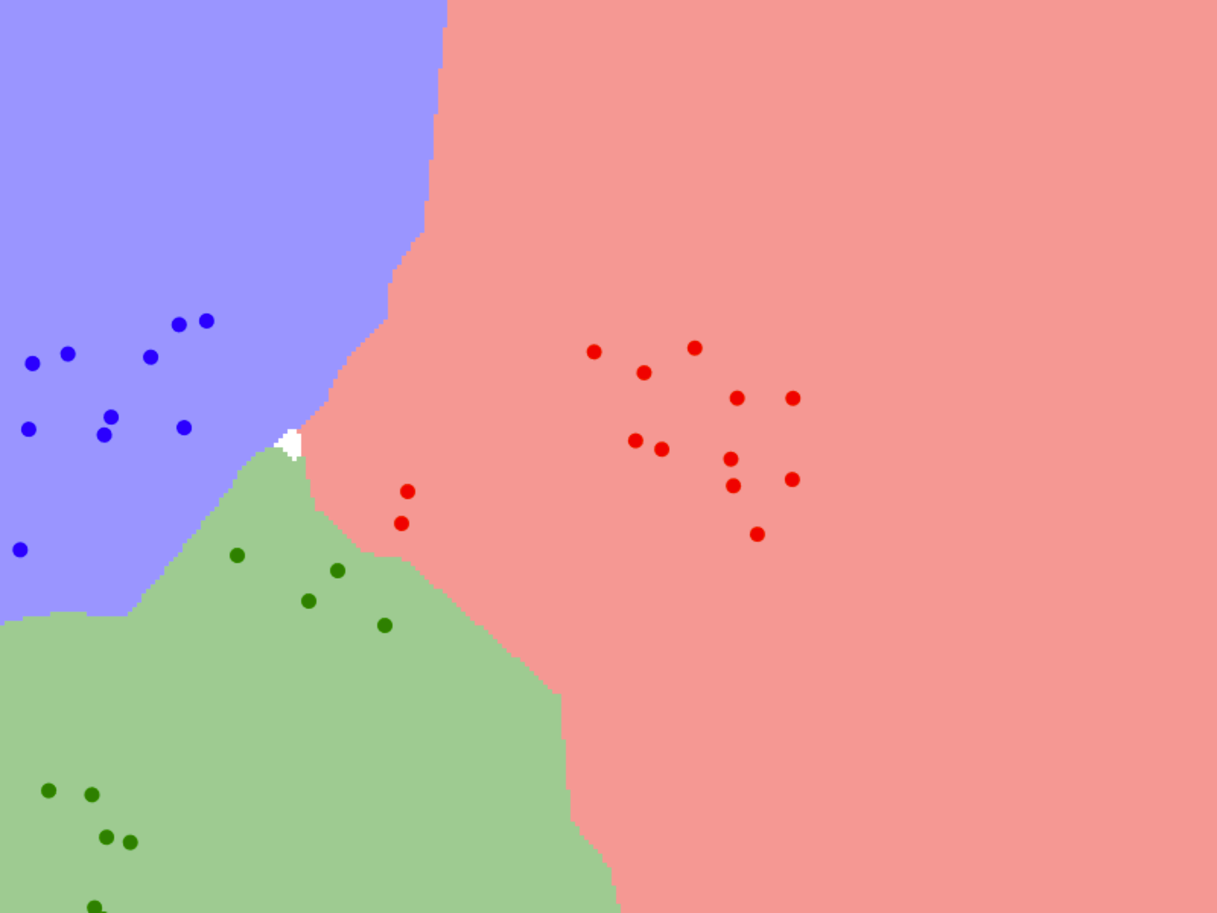
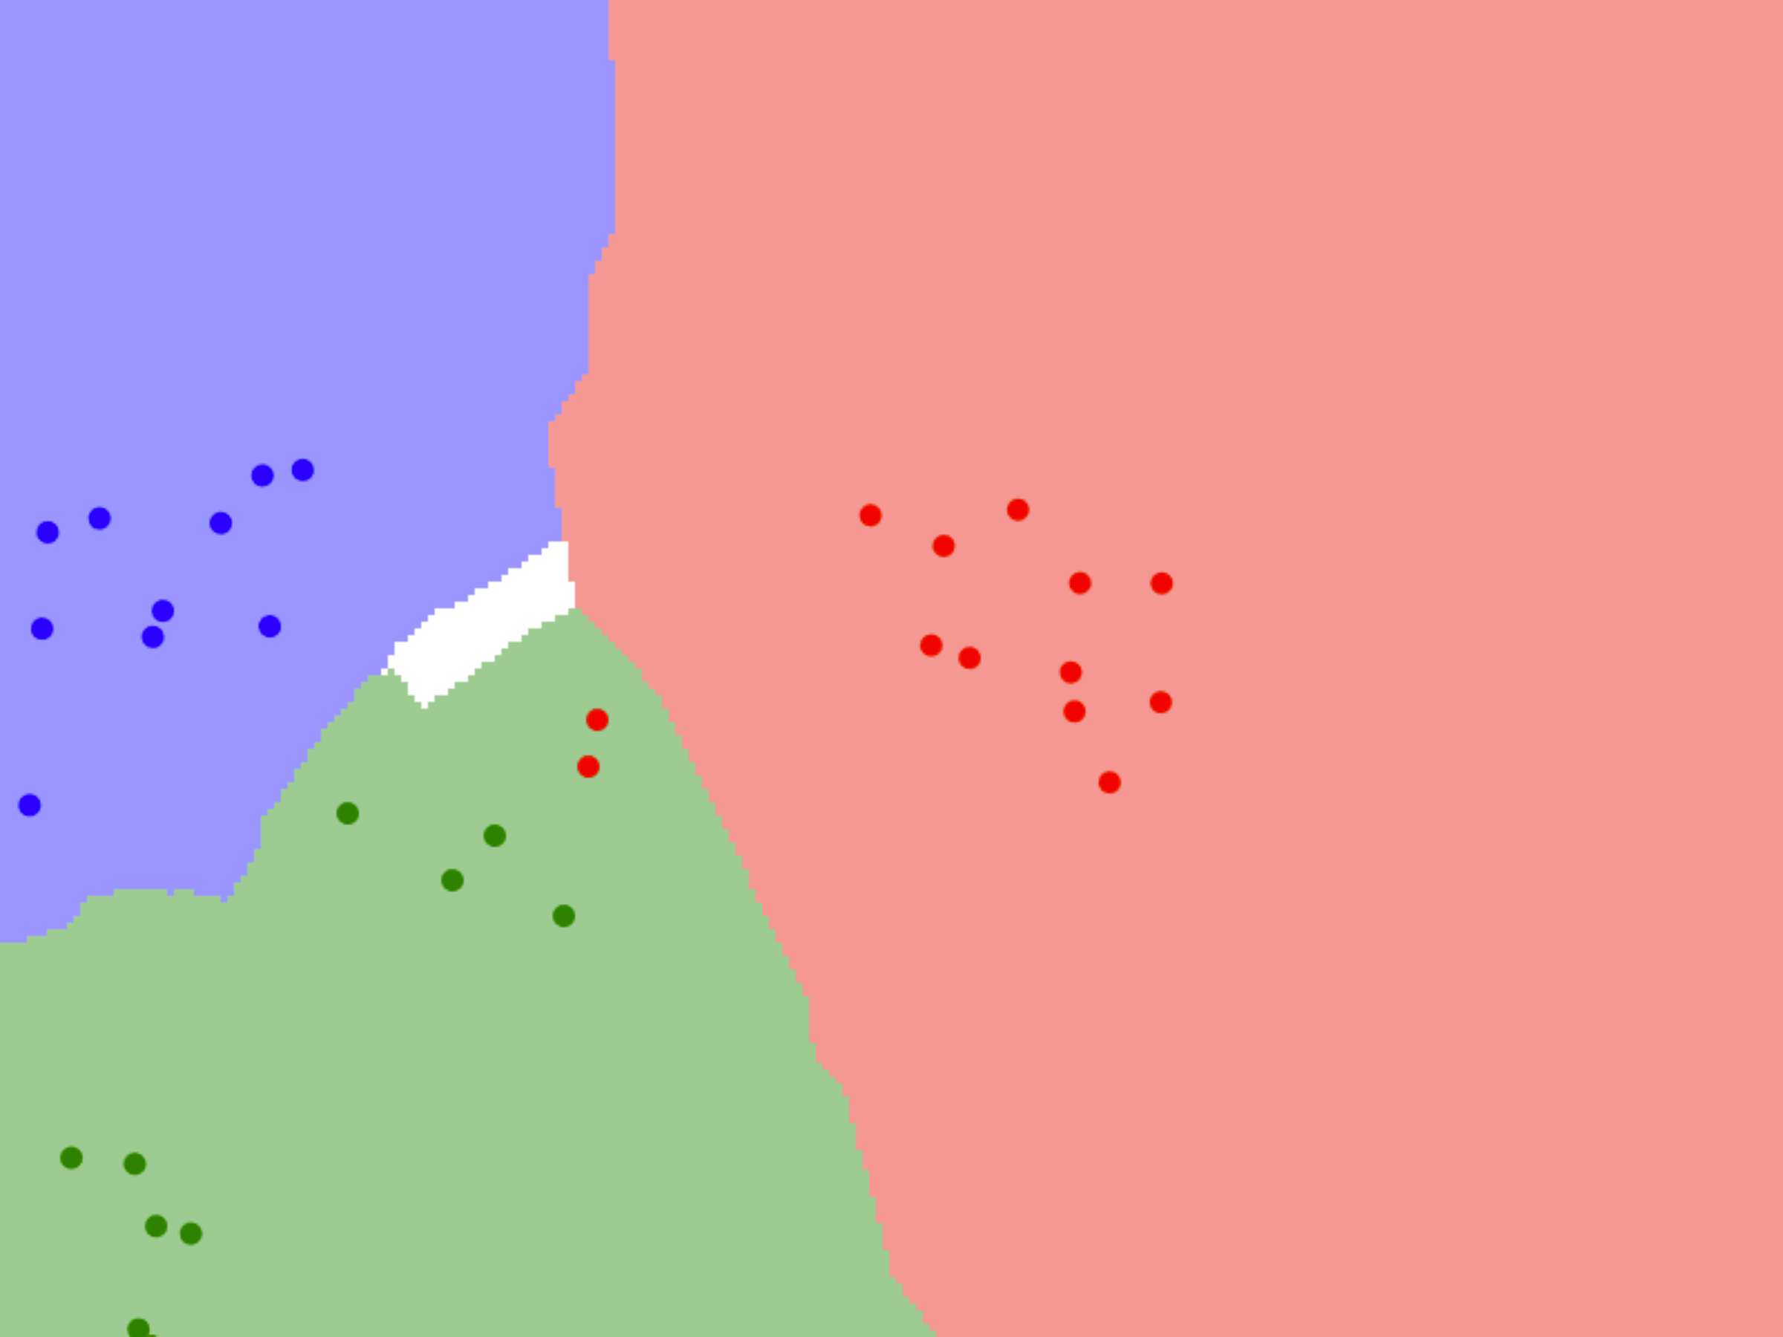
K-nearest neighbors
Supervised learning model
Predicts by calculating distance to neighboring points
k = 3
k = 5

Slide 13
My model
Uses a k-nearest neighbors algorithm
81% train - 9% validation - 10% test
Removed redshift, peak absolute magnitude
Parameters
L2 (Euclidean) distance
Uniform weights
k = 20

Slide 14
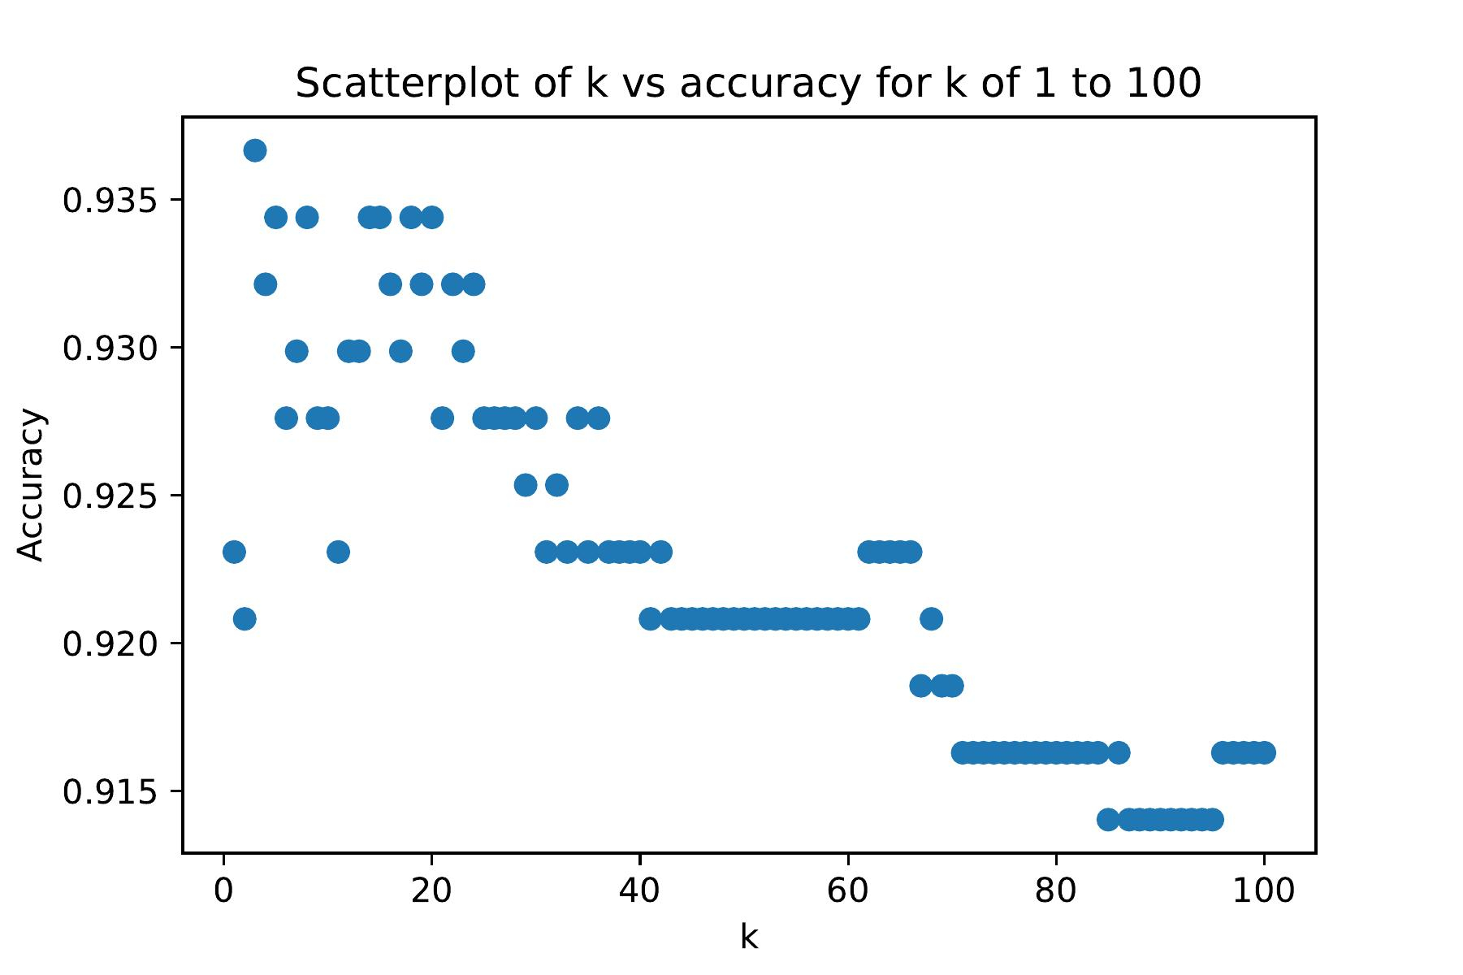
My Model

Slide 15
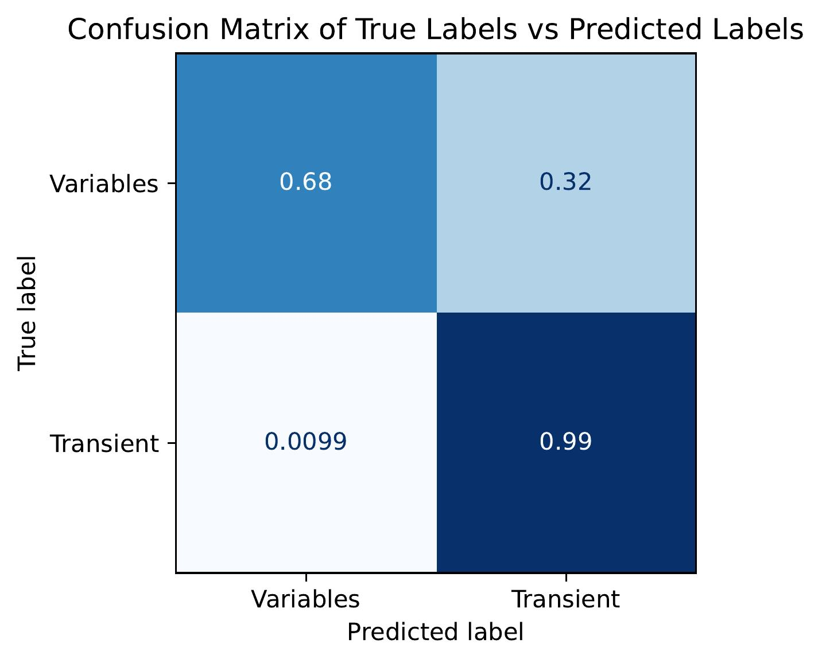
Findings
Model
Accuracy: 93.7%
Precision: 0.948
Recall: 0.983
Can now sort unsorted data
Allows research into “BTS rejects”

Slide 16
Thank You!
Summary
Old backlog of unclassified data
Trained kNN model on BTS data
93.7% accuracy
Allows research into the backlog of data
Questions?

Slide 17
References
Perley et al. 2020ApJ...904...35P
Eric C. Bellm et al 2019 PASP 131 068003
Eric C. Bellm et al 2019 PASP 131 018002
https://www.ipac.caltech.edu/news/212
http://vision.stanford.edu/teaching/cs231n-demos/knn/

